Slide 1
Customer Segmentation using Data Science
Innovation techniques
Example programs
Outputs diagrams

Slide 2






Dimensionality reduction techniques: Visualizing complex data sets in 2D

Slide 3

definition
In statistics, dimension reduction techniques are a set of processes for reducing the number of random variables by obtaining a set of principal variables. For example, in the context of a gene expression matrix across different patient samples, this might mean getting a set of new variables that cover the variation in sets of genes. This way samples can be represented by a couple of principal variables instead of thousands of genes. This is useful for visualization, clustering and predictive modeling.

Slide 4

Principal component analysis
Principal component analysis (PCA) is maybe the most popular technique to examine high-dimensional data. There are multiple interpretations of how PCA reduces dimensionality. We will first focus on geometrical interpretation, where this operation can be interpreted as rotating the original dimensions of the data. For this, we go back to our example gene expression data set. In this example, we will represent our patients with expression profiles of just two genes, CD33 (ENSG00000105383) and PYGL (ENSG00000100504). This way we can visualize them in a scatter plot

Slide 5
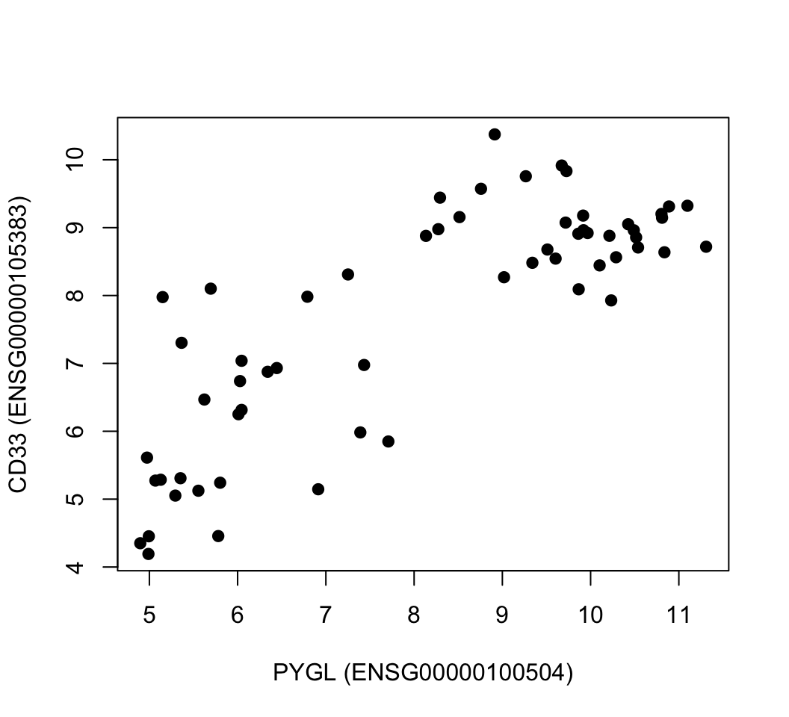
Principal component analysis
Example program
plot(mat[rownames(mat)=="ENSG00000100504",],
mat[rownames(mat)=="ENSG00000105383",],pch=19,
ylab="CD33 (ENSG00000105383)",
xlab="PYGL (ENSG00000100504)")

Slide 6

Singular value decomposition and principal component analysis
A more common way to calculate PCA is through something called singular value decomposition (SVD). This results in another interpretation of PCA, which is called “latent factor” or “latent component” interpretation. In a moment, it will be clearer what we mean by “latent factors”. SVD is a matrix factorization or decomposition algorithm that decomposes an input matrix,X, to three matrices as follows: X=USVTX.A more common way to calculate PCA is through something called singular value decomposition (SVD). This results in another interpretation of PCA, which is called “latent factor” or “latent component” interpretation. In a moment, it will be clearer what we mean by “latent factors”. SVD is a matrix factorization or decomposition algorithm that decomposes an input matrix,X, to three matrices as follows: X=USVTX.

Slide 7
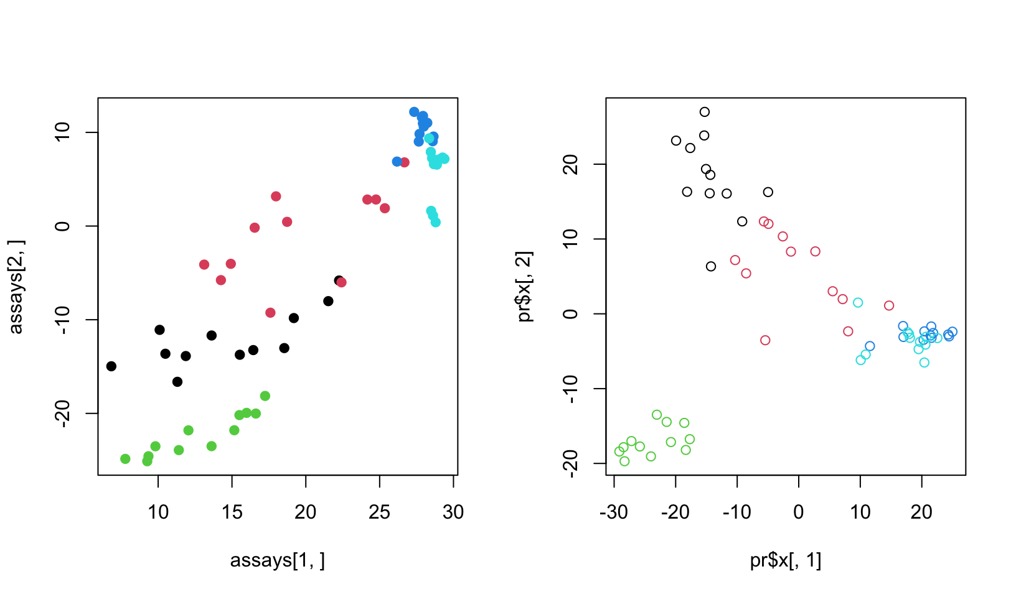
SVD on the matrix and its transpose
par(mfrow=c(1,2))
d=svd(scale(mat)) # apply SVD
assays=t(d$u) %*% scale(mat) # projection on eigenassays
plot(assays[1,],assays[2,],pch=19,
col=as.factor(annotation_col$LeukemiaType))
#plot(d$v[,1],d$v[,2],pch=19,
# col=annotation_col$LeukemiaType)
pr=prcomp(t(mat),center=TRUE,scale=TRUE) # apply PCA on transposed matrix
# plot new coordinates from PCA, projections on eigenvectors
# since the matrix is transposed eigenvectors represent
plot(pr$x[,1],pr$x[,2],col=as.factor(annotation_col$LeukemiaType))

Slide 8
THANK YOU

